Slide 1


Modernizing Agricultural Practice using Internet of Things
MAPIoT Summer School in Norway
24.07.2022 – 07.08.2022
Melsom High School, Sandefjord organized by University of South-Eastern Norway
AI (neural networks), GA (genetic algorithms) & Fuzzy Rules
– applied in Modelling, Control, Predicting and Managing of processes from Agriculture and Food Engineering domains –
Professor Adrian FLOREA, PhD
Lucian Blaga University of Sibiu
adrian.florea@ulbsibiu.ro
¹) The digital materials do not reflect the views of Financial Mechanism Office (FMO), and they do not purport to be representative of the countries, regions and themes they illustrate. The use of the materials does not imply endorsement by the FMO, the Donor States, the Beneficiary States, or any other stakeholder of the EEA and Norway Grants. The FMO is not liable for any law infringements by third parties in the context of the operation and use of the media library.
HPI Knowledge Transfer Institute at ULBS
http://centers.ulbsibiu.ro/itchpiulbs/en/
Notes:
Cursurile pot fi poate dificil de inteles pentru studentii care nu sunt la Computer Science. Pe de alta parte este foarte important si pentru acestia sa inteleaga cate lucruri pot fi realizate si la care colegii din IT ii pot ajuta sa dezvolte solutii la probleme identificate de ei – specialistii in Agricultura si Food Engineering.

Slide 2
MAPIoT Motivation
Societal Challenges
Food waste (1/3 of produced food is lost/wasted every year)
Population growth, industrialization and transition to cities => limitation of resources (water, energy), weather uncertainty and climate change
Inefficiency in planting, harvesting, feeding, monitoring, water use
In the agricultural sector, there are significant disparities between EU countries
Technical Challenges
Agriculture is now moving into the information age, where data are collected and analysed to improve both production and quality
Technological gap, lack of digitalization (digital technologies and Internet connectivity)
Need for Knowledge Transfer of IT in Agriculture and Food processing / security domains
Notes:
Reducing Food waste => Implementing sustainable food production systems and resilient practices in agriculture, especially for developing countries, such that by 2030 the hunger and malnutrition will end worldwide.
International cooperation for protecting wetlands and rivers, the sharing water treatment technologies to ensure clean water and sanitation of the planet’s population in the conditions of population growth and climate changes.
Reduce the digital gap (digital technologies and Internet connectivity) between countries and promote sustainable development in industry and agriculture by investment in scientific research, innovation, and infrastructure.

Slide 3
MAPIoT Motivation
Proposed Solutions
April 2019, EU member states signed the declaration of cooperation on “A smart and sustainable digital future for European agriculture and rural areas”
Investment in education, scientific research, innovation, and infrastructure
Waste recycling, more responsible consumption
Internet of Things (IoT) plays an essential role in innovative developments
Introducing in Agriculture / Food Engineering domains automation and robotics, smart drones, IoT systems, or new methods for processes monitoring, control or prediction using algorithms of computer vision, Artificial Intelligence (AI), Genetic Algorithms (GA) and knowledge-based systems (Fuzzy Rules) as sustainable software applications

Slide 4
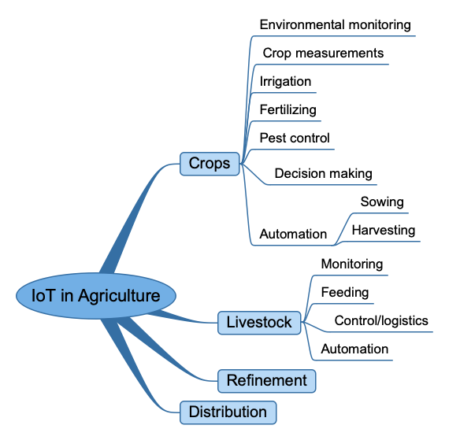
IoT in agriculture: examples

Slide 5
Applying AI in Modelling, Control, Predicting and Managing of processes from Agriculture and Food Engineering domains
Solutions
Using neural networks (NN):
  to obtain indirect information about the state variables in an alcoholic fermentation process
  to detect fruit / plant diseases & nutrient deficiency in very initial stage based on image processing and pattern matching
  to identify ripe vegetables and fruits by analysing shape and colour --> crop growth and harvesting optimization
  forecasting of production in agriculture on the basis of a wide range of independent variables, caused by unexpected crisis (war, climate changes), lack of water, population growth
  if we can predict the probability of a specific product for food recall, this will help food producers to improve food safety & reduce food waste
Notes:
Deep learning (also known as deep structured learning) is part of a broader family of machine learning methods based on artificial neural networks with representation learning in which multiple layers of processing are used to extract progressively higher level features from data. Neural networks and deep learning currently provide the best solutions to many problems in image recognition.
Normal (health) / Blotch / Scab / Rotten Apple
Grape disease analyzing leaves
https://youtu.be/sVuORaGMobw - A robot
adaugarea unei camere care sa identifice elemente de același fel și sa cream poziția dinamic la care bratul sa acționeze si sa umple mbotul. Când e plin (tot camera sa detecteze) mbotul pleaca si descarca. is about to assist you in your next summer job

Slide 6
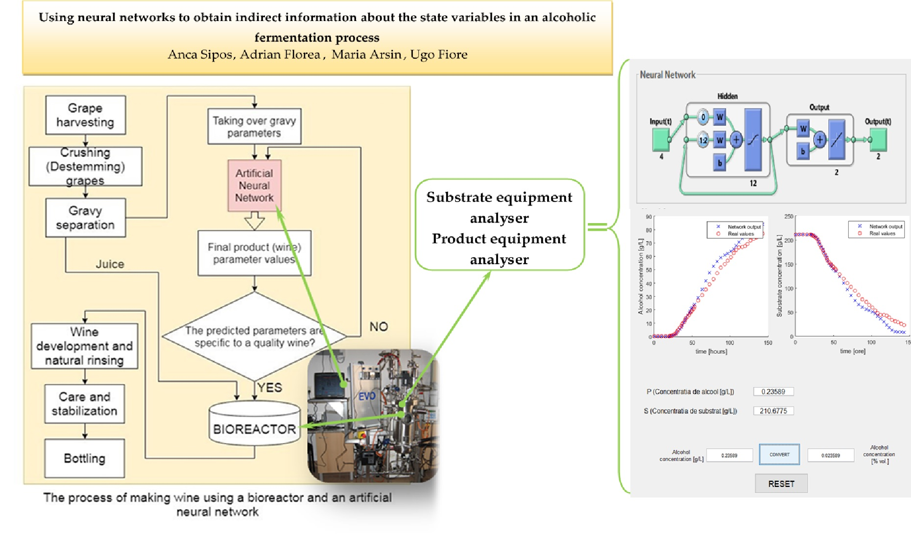

Slide 7
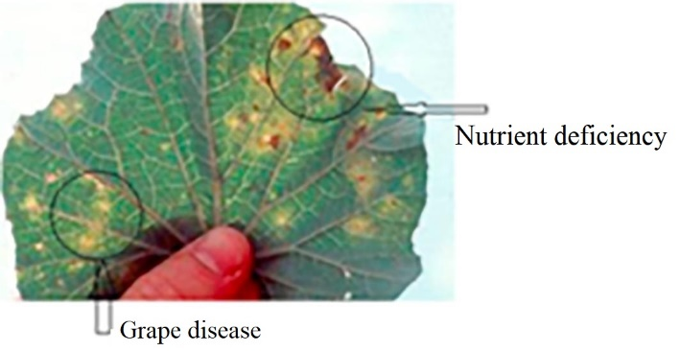
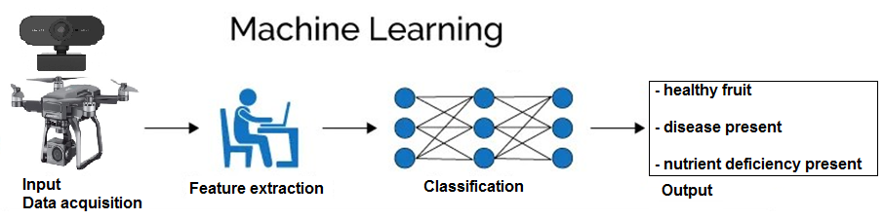
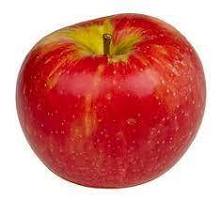
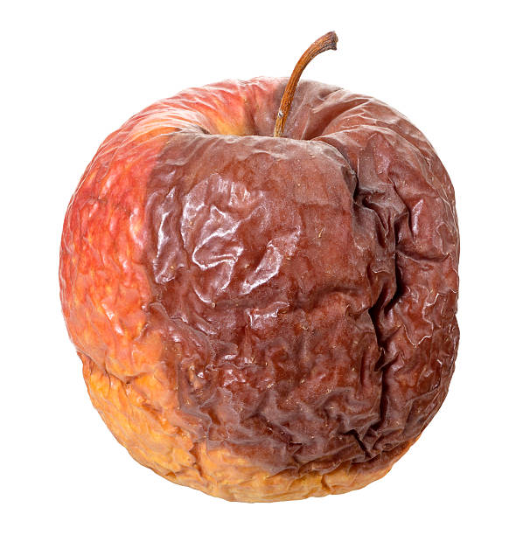
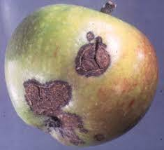
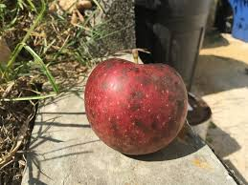
  Using NN to detect fruit / plant diseases & nutrient deficiency in very initial stage based on image processing and pattern matching
Normal (health) / Blotch / Scab / Rotten Apple
Notes:
Deep learning (also known as deep structured learning) is part of a broader family of machine learning methods based on artificial neural networks with representation learning in which multiple layers of processing are used to extract progressively higher level features from data. Neural networks and deep learning currently provide the best solutions to many problems in image recognition.
Normal (health) / Blotch / Scab / Rotten Apple
Grape disease analyzing leaves
https://youtu.be/sVuORaGMobw - A robot
adaugarea unei camere care sa identifice elemente de același fel și sa cream poziția dinamic la care bratul sa acționeze si sa umple mbotul. Când e plin (tot camera sa detecteze) mbotul pleaca si descarca. is about to assist you in your next summer job

Slide 8
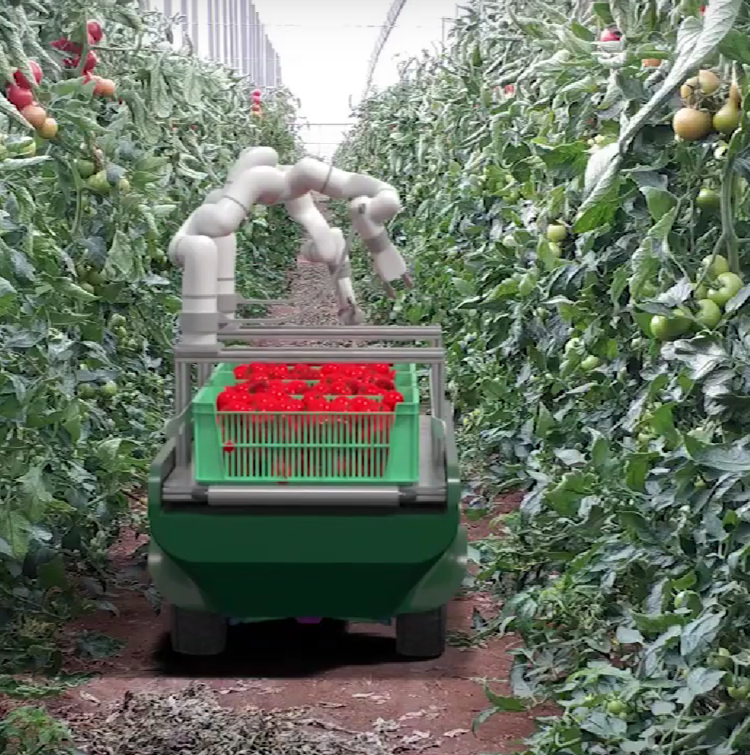
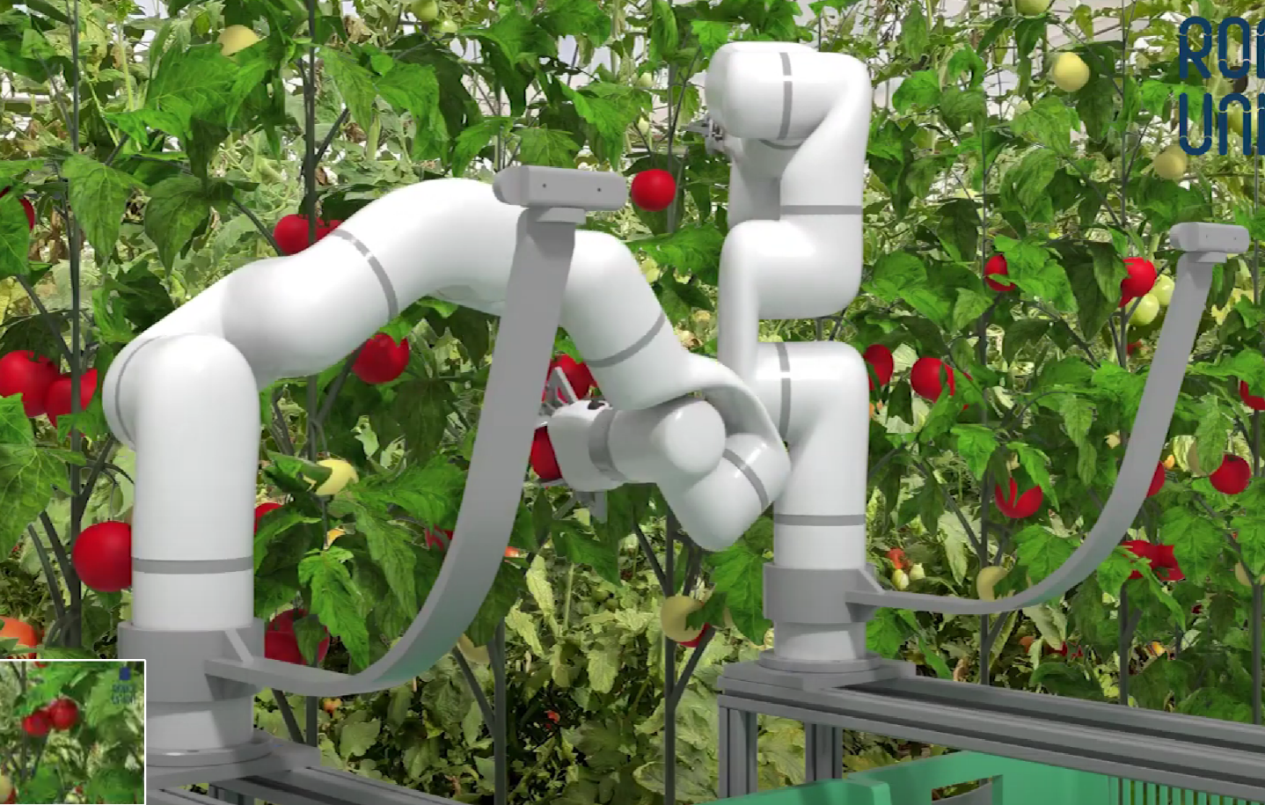
  Robot able to harvest tomatoes
  Combine Computer Vision with Neural Networks for shape and colour prediction to identify the right moment of harvesting

Slide 9
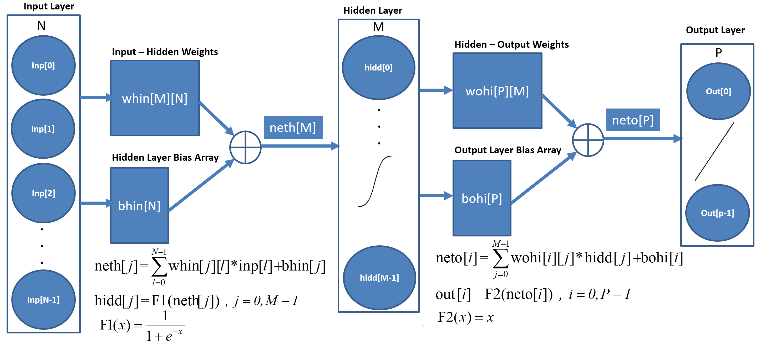
  Forecasting of production in agriculture on the basis of a wide range of independent variables, caused by unexpected crisis (war, climate changes), lack of water, population growth: customized Artificial Neural Network for Crop Yield Prediction

Slide 10
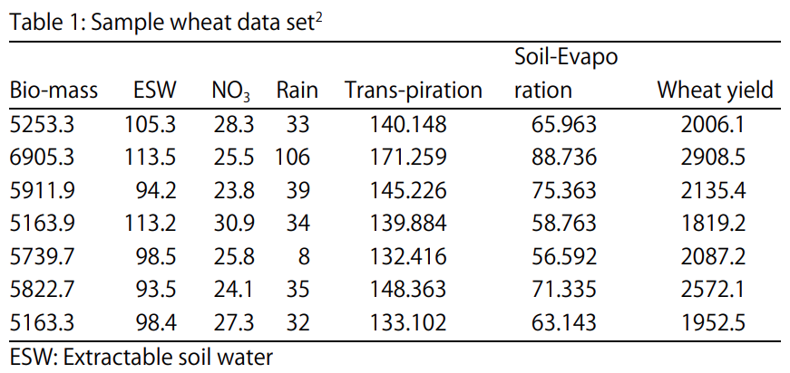
  Customized Artificial Neural Network for Crop Yield Prediction
The parameters considered for wheat yield prediction:
Biomass (kg⋅ha⁻¹) is the accumulated energy in plants
ESW (mm) is the extractable soil water
NO₃ (kg⋅ha⁻¹) is nitrogen content present in soil
Rain (mm) is amount of rainfall since sowing
Transpiration (mm) is the amount of water evaporated from the leaf
Soil evaporation (mm) is the amount of water evaporated from soil
Historic wheat yield (kg⋅ha⁻¹) from previous period

Slide 11
Applying AI in Modelling, Control, Predicting and Managing of processes from Agriculture and Food Engineering domains
Solutions
Using Genetic Algorithms (GA):
  Optimization:
    of planning the harvesting
    Automatic design space exploration
  Simulation:
    Identification of natural resource sets for maximizing regional diversity and maintaining long-term biodiversity
    Simulation based optimization in computer architectures, maintenance processes
  Modeling:
    Global climate modelling.
    Train the Neural Networks. Generating initial weights

Slide 12
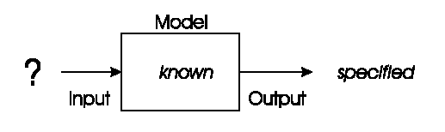
Problem type 1: Optimization
We have a model of our system and seek inputs that give us a specified goal!
  Optimization of planning the harvesting according to the area and the number of harvesting fields, the number of harvesting machines (combines), the number of drivers, the number of warehouses and the quantity that fits in the warehouses to reduce both the working time and the fuel (multi-objective optimization problem)
  Optimization: Automatic design space exploration

Slide 13
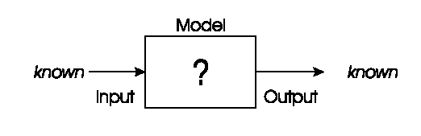
Problem types 2: Modelling
We have corresponding sets of inputs & outputs and seek model that delivers correct output for every known input!
Modeling:
Global climate modelling, results are more precise if not only the atmosphere and the oceans, but also the rainforests, deserts and cities are modelled.
Train the Neural Networks. Generating initial weights

Slide 14
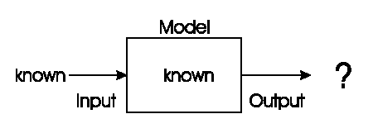
Problem type 3: Simulation
We have a given model and wish to know the outputs that arise under different input conditions!
Simulation:
Identification of natural resource sets for maximizing regional diversity and maintaining long-term biodiversity
Simulation based optimization in computer architectures, maintenance processes

Slide 15
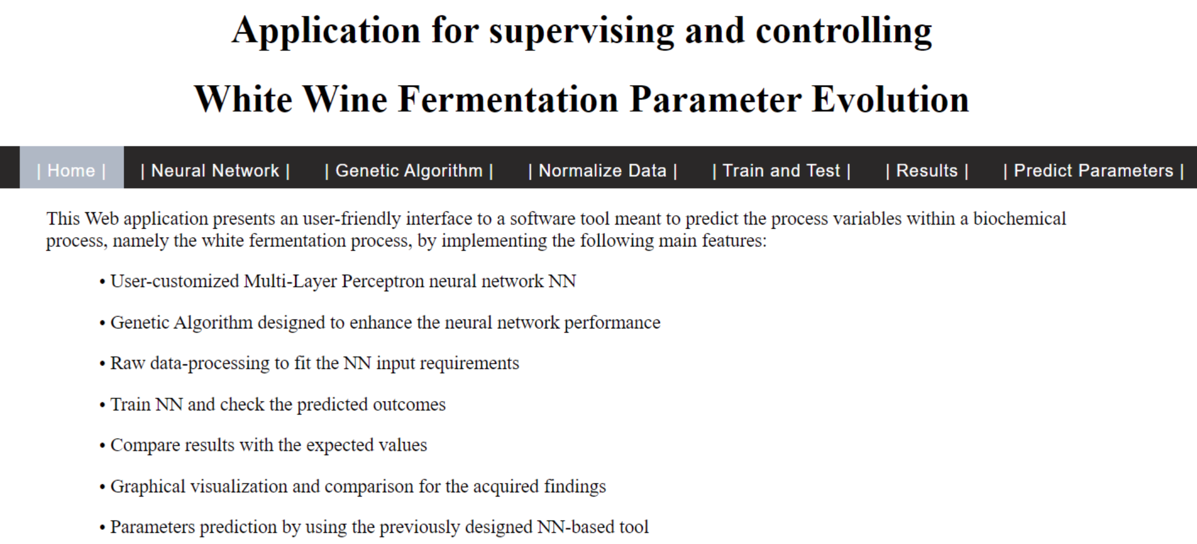
Applying AI in Modelling, Control, Predicting and Managing of processes from Agriculture and Food Engineering domains
Training the Neural Networks initial weights
http://193.226.29.27/WineFermentation/

Slide 16
Applying AI in Modelling, Control, Predicting and Managing of processes from Agriculture and Food Engineering domains
Solutions
Using Fuzzy Rules (FR) for modeling of imprecise concepts:
  To automate and control the irrigation process
  To detect the fermentation phase
  To reduce the design space of parameters and improve the quality of solutions
Fuzzy logic are based on fuzzy set theory developed by Lotfi Zadeh since 1965.

Slide 17
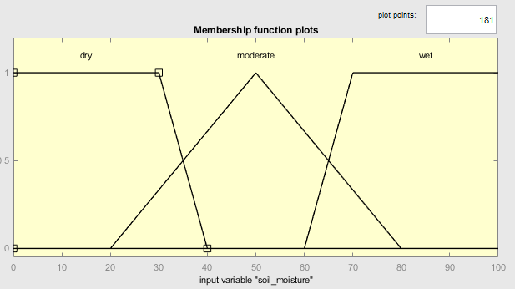
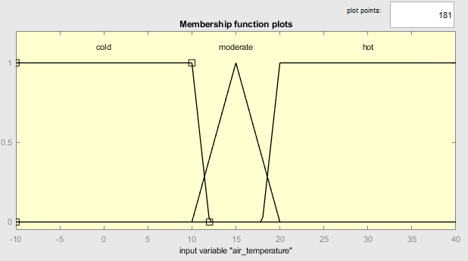
Irrigation system
FUZZY LOGIC SYSTEM: Variables
Four inputs / Each has defined 3 membership functions
Soil Moisture {DRY, MODERATE, WET}
Air Humidity {LOW, MODERATE, HIGH}
Light Intensity {DARK, MODERATE, BRIGHT}
are represented in percentage with values in [0, 100] interval
Air Temperature {COLD, MODERATE, HOT }
is represented in Celsius degrees in [-30, 40] interval.
One output:
Irrigation Time {NONE, SHORT, MEDIUM, LONG, VERY LONG}
The output is calculated with the centroid defuzzification method.

Slide 18
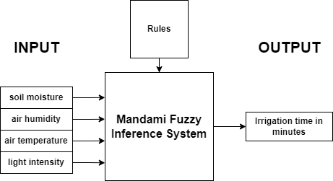
Irrigation system SINK:
MANDAMI INFERENCE FUZZY LOGIC SYSTEM (1)
R1: IF (soil_moisture IS wet) AND (air_temperature IS cold) AND (air_humidity IS high) AND (light_intensity IS bright) THEN (irrigation_time IS none)
R2: IF (soil_moisture IS dry) AND (air_temperature IS moderate) AND (air_humidity IS low) AND (light_intensity IS moderate) THEN (irrigation_time IS very_long)
The rules were chosen on nursery managers’ experience.
Disadvantage: We need to define 3^4=81 rules.

Slide 19
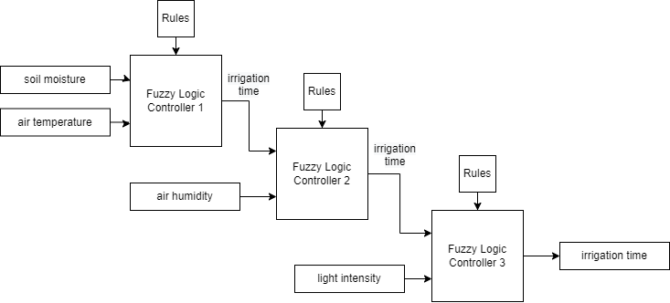
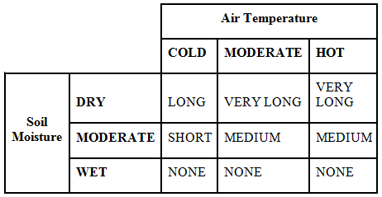
Irrigation system SINK:
MANDAMI INFERENCE FUZZY LOGIC SYSTEM (2)
Solution:
Cascaded rules =>
the number of rules decreases, the performance
increases and it is easier to define them
Rules of FLC 1

Slide 20
Neural Networks (NN)
Short history
AI: domain affiliation
What are NN? Advantages. Challenges
Types of Neural Networks
Structure of an artificial neuron
Activation functions
Simple perceptron and Multi-Layer Perceptron. Constraints
Learning Mechanism: Backpropagation
Source code examples: MATLAB and C#
  Creating the network
  Selection of activation function
  Metrics
  Training
  Application & Results
Notes:
Categorisire: part of AI and pattern matching (Process 2020) and paralel and distributed Systems
Multistrat/Single perceptron
Feedback/Feedforward
Constrângeri (neuronii de pe același strat nu sunt conectati)
Exemplu Matlab (cod sursa)
Crearea rețelei, alegerea funcției de activare
Rezultate

Slide 21
History of Neural Networks (I)
The idea of “a machine that thinks” can be traced to the Ancient Greeks.
Next, focus on the key events that led to the evolution of thinking around neural networks:
  1943: Warren S. McCulloch and Walter Pitts published “A logical calculus of the ideas immanent in nervous activity”. This research sought to understand how the human brain could produce complex patterns through connected brain cells, or neurons. One of the main resulting ideas was the comparison of neurons with a binary threshold to Boolean logic (0/1 or true/false statements).
  1958: Frank Rosenblatt is credited with the development of the perceptron - “The Perceptron: A Probabilistic Model for Information Storage and Organization in the Brain”. He takes McCulloch and Pitt’s work a step further by introducing weights to the equation. Leveraging an IBM 704, Rosenblatt was able to get a computer to learn how to distinguish cards marked on the left vs. cards marked on the right.

Slide 22
History of Neural Networks (II)
1969: Marvin Minsky and Seymour Papert have analysed the learning possibilities of the perceptron and reached rather sceptical conclusions, proving the impossibility for the single-layer perceptron to solve simple problems such as learning the XOR function (a function that is not linearly separable).
1974: While numerous researchers contributed to the idea of backpropagation, Paul Werbos was the first person in the US to note its application within neural networks within his PhD thesis.
1989: Yann LeCun published a paper illustrating how the use of constraints in backpropagation and its integration into the neural network architecture can be used to train algorithms. This research successfully leveraged a neural network to recognize hand-written zip code digits provided by the U.S. Postal Service.
Notes:
Constrained backpropagation (CBP) algorithm based on the pseudo-Lagrange multiplier method to obtain the optimal set of weights that satisfy a given set of constraints

Slide 23
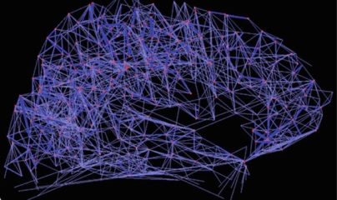
Neural Networks: What are?
Neural networks try to simulate the neurophysiological structure of the human brain.
Their name and structure are inspired by the human brain, mimicking the way that biological neurons signal to one another.
  The cortex is composed of a large number of interconnected biological cells called neurons. Each neuron receives signals from the neurons connected to it through the dendrites and conveys a signal using the axon.
NNs allow computer programs to recognize patterns and solve common problems.
Also known as artificial neural networks (ANNs) or simulated neural networks (SNNs), are a subset of machine learning and are at the heart of deep learning algorithms.

Slide 24
Types of Neural Networks
There are several types of artificial NNs classified according to different factors:
From a purpose point of view, NNs can be viewed as part of the larger domain of pattern recognition and Artificial Intelligence by the necessity of learning (supervised vs. not-supervised).
From the point of view of the method applied, NNs fall within the parallel distributed processing domain.
The topological structure of the neurons:
single-layer networks
multilayer networks
The direction in which the signals flow:
feed-forward networks
feedback networks
Notes:
Categorisire: part of AI and pattern matching (Process 2020) and paralel and distributed Systems
Multistrat/Single perceptron
Feedback/Feedforward
Constrângeri (neuronii de pe același strat nu sunt conectati)
Exemplu Matlab (cod sursa)
Crearea rețelei, alegerea funcției de activare
Rezultate

Slide 25
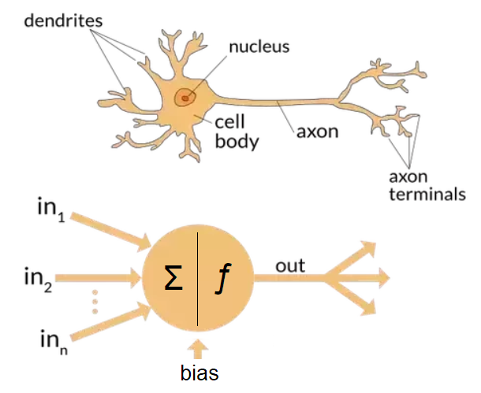
The biological and the artificial neuron
There are between 86 to 100 billion interconnected neurons by synapses.
Active – if the information entering the neuron exceeds a certain stimulation threshold
Pasive – otherwise
Biological NN | Artificial NN
Cell body | Network node
Dendrites | Inputs in NN
Axon | Output of NN
Activation | Processing
Synapses | Weighted links
Images from “A biological and an artificial neuron” (via https://www.quora.com/What-is-the-differences-between-artificial-neural-network-computer-science-and-biological-neural-network)
Notes:
There are between 86 to 100 billion interconnected neurons by synapses.
Estimating the number of neurons in the brain seems fairly simple on the surface. Simply take a sample of the brain, count the number of neurons in that sample and then extrapolate that information to account for the remaining brain volume.
14 billion neurons amount to pretty much the number of neurons that a baboon brain has or almost half the number of neurons in the gorilla brain.
The human brain is more energy-efficient than computers. Our 10 billion neurons only use 10 watts – that's 10x more efficient than computers. That explains why you can still read a book even if you're very tired. Or why you can still process things in the morning even if you're just half asleep.
Unlike computers, human brains are massively parallel in their organisation, concurrently running many millions of separate processes. They must do this because they are not designed to perform a specific set of actions but to select from a vast repertoire of alternatives that the fundamental unpredictability of our environment offers us.
The fastest synaptic transmission takes about 1 millisecond. Thus both in terms of spikes and synaptic transmission, the brain can perform at most about a thousand basic operations per second, or 10 million times slower than the computer.
Sinapsă
• Legătura între axon-ul unui neuron şi dendritele altui neuron
• Are rol în schimbul de informaţie dintre neuroni
▪ 5.000 de conexiuni / neuron (în medie)

Slide 26
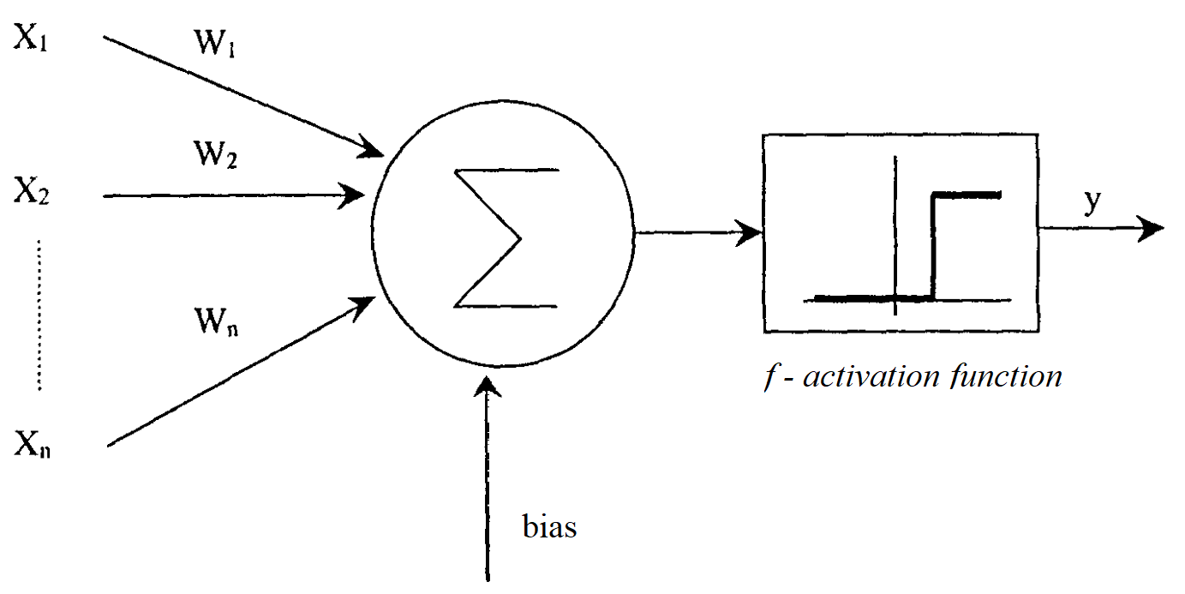


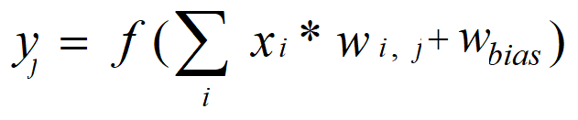
Mathematical model of an artificial neuron
Notes:
Categorisire: part of AI and pattern matching (Process 2020) and paralel and distributed Systems
Multistrat/Single perceptron
Feedback/Feedforward
Constrângeri (neuronii de pe același strat nu sunt conectati)
Exemplu Matlab (cod sursa)
Crearea rețelei, alegerea funcției de activare
Rezultate

Slide 27
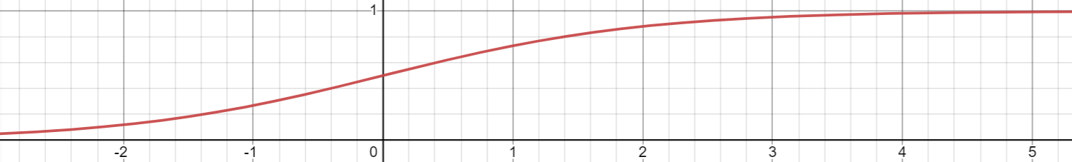
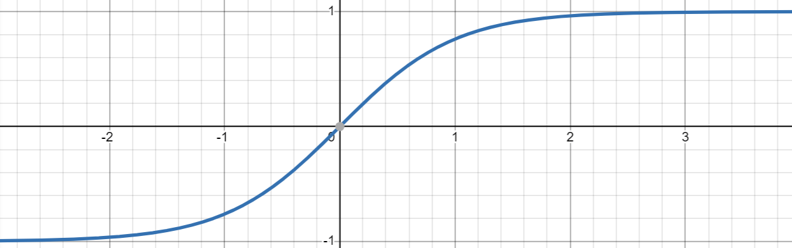
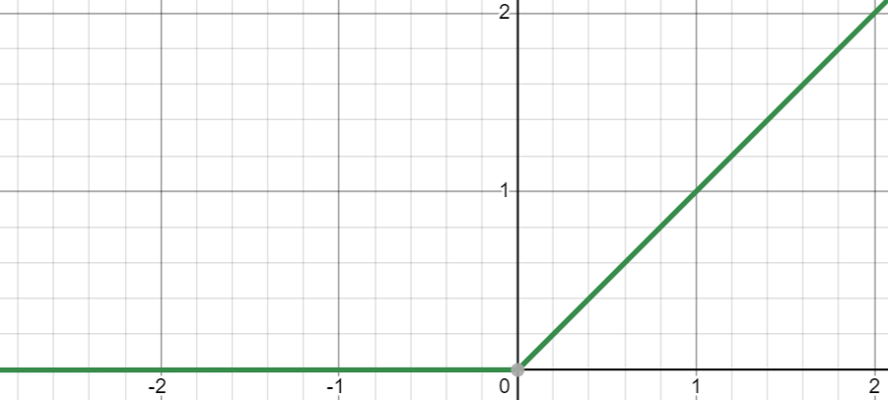
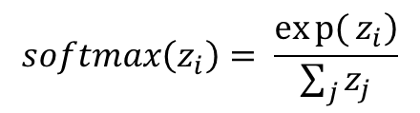

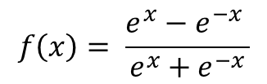
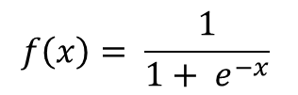
Types of Activation Functions
Sigmoid function
$$f\left(x\right)= \frac{1}{1+ e^{−x}}$$
Hyperbolic tangent function
$$f\left(x\right)= \frac{e^{x}−e^{−x} }{e^{x}+e^{−x}}$$
ReLU (rectified linear unit) function
$$f\left(x\right)=\max\left(0,x\right)$$
Softmax function
$$softmax\left(z_{i}\right)= \frac{\left.exp{(}z_{i}\right)}{\sum_{j}{z_{j}}}$$
Notes:
Funcția de activare este la „capătul” structurii neuronale și corespunde aproximativ axonului unui neuron biologic.
Rolul functiilor de activare - to help the network learn complex patterns in the data.
Activation function decides, whether a neuron should be activated or not by calculating weighted sum and further adding bias with it. The purpose of the activation function is to introduce non-linearity into the output of a neuron.
Actually try to model the classification (Not Taken or 0 and Taken or 1).

Slide 28
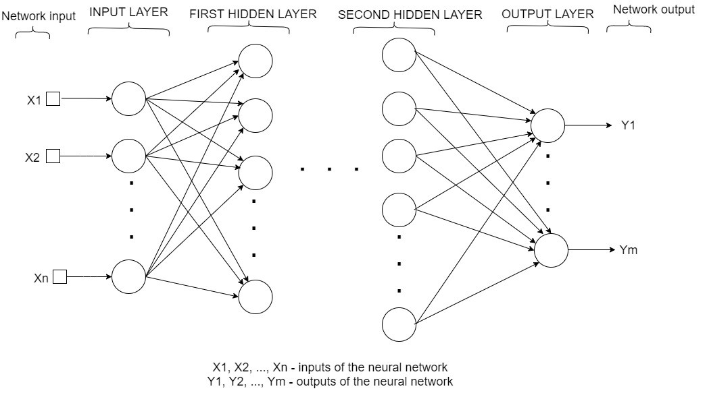
The architecture of a generic multilayer neural network with two hidden layers – feed forward
Notes:
Categorisire: part of AI and pattern matching (Process 2020) and paralel and distributed Systems
Multistrat/Single perceptron
Feedback/Feedforward
Constrângeri (neuronii de pe același strat nu sunt conectati)
Exemplu Matlab (cod sursa)
Crearea rețelei, alegerea funcției de activare
Rezultate

Slide 29
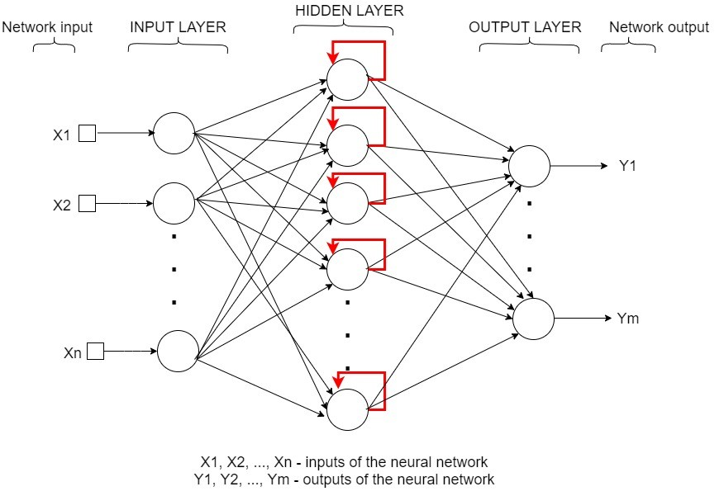
The architecture of a generic multilayer neural network with two hidden layers – feedback (recurrent)
Notes:
Categorisire: part of AI and pattern matching (Process 2020) and paralel and distributed Systems
Multistrat/Single perceptron
Feedback/Feedforward
Constrângeri (neuronii de pe același strat nu sunt conectati)
Exemplu Matlab (cod sursa)
Crearea rețelei, alegerea funcției de activare
Rezultate

Slide 30
Neural Networks (NN)
Simple perceptron and Multi-Layer Perceptron. Constraints
Learning Mechanism: Backpropagation
Source code examples: Matlab and C#
  Creating the network
  Selection of activation function
  Metrics
  Training
  Application & Results
    Florea, A., Sipos, A., & Stoisor, M. C. (2022). Applying AI Tools for Modeling, Predicting and Managing the White Wine Fermentation Process. Fermentation, 8(4), 137.
Notes:
Categorisire: part of AI and pattern matching (Process 2020) and paralel and distributed Systems
Multistrat/Single perceptron
Feedback/Feedforward
Constrângeri (neuronii de pe același strat nu sunt conectati)
Exemplu Matlab (cod sursa)
Crearea rețelei, alegerea funcției de activare
Rezultate

Slide 31
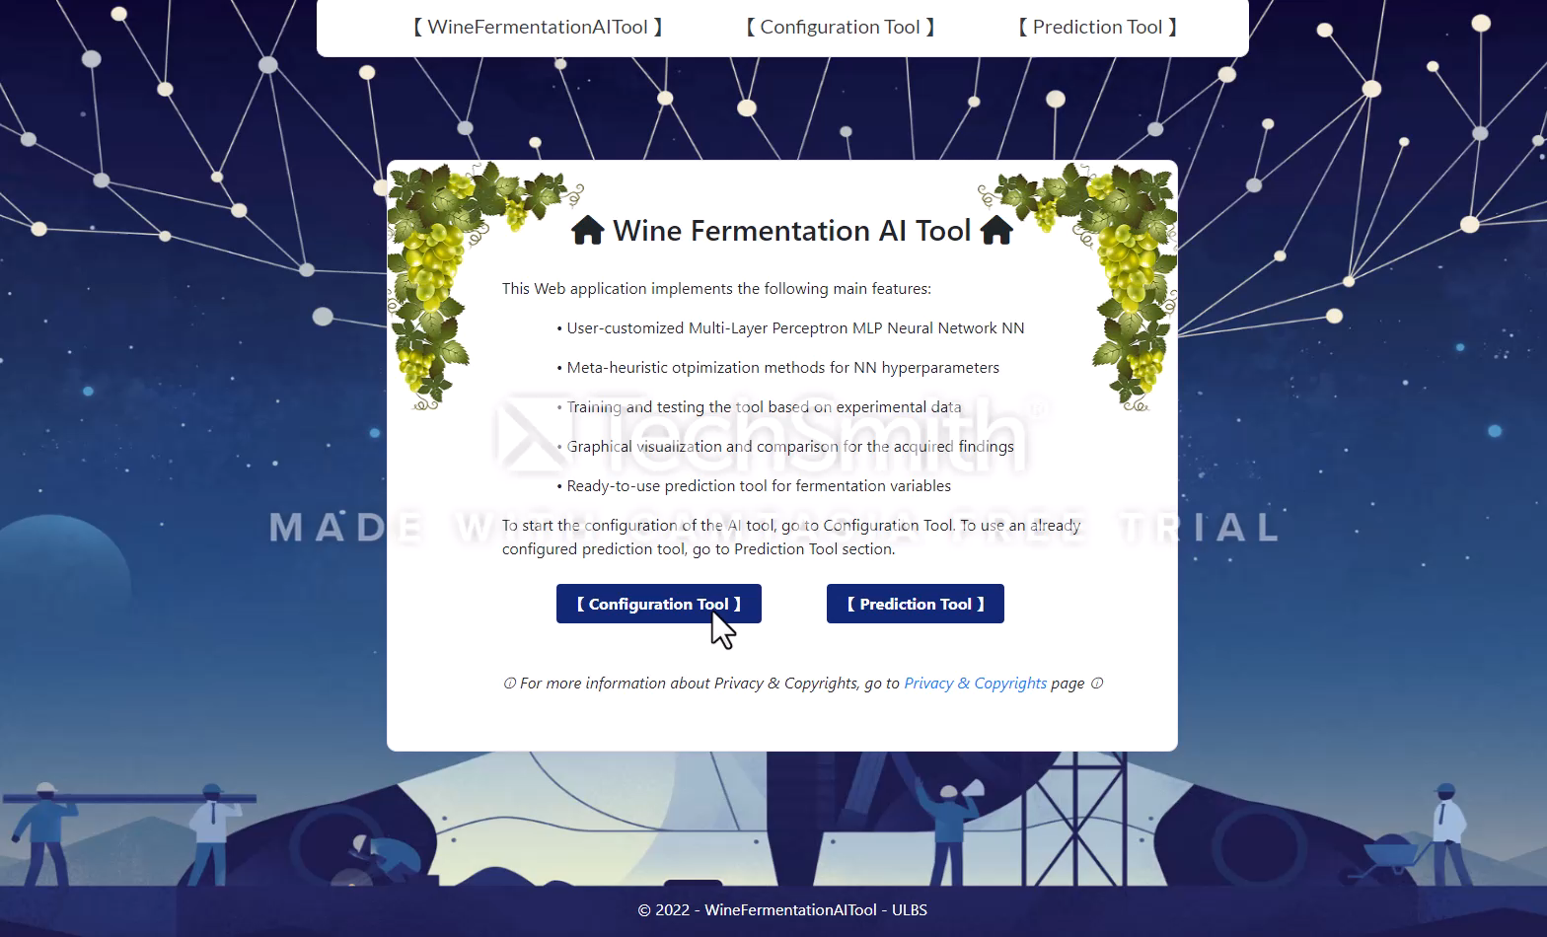
USER INTERFACE

Slide 32
1st approach: NN implementation in MATLAB
% ******* CREATE NETWORK ***********************
% create vector dimensiune retea
dimensiune_retea = [];
for i = 1:nr_straturiAscunse
dimensiune_retea = [dimensiune_retea nr_neuroni];
end
network = newff(input_antrenareRetea,target_antrenareRetea, dimensiune_retea);
%******* TRAIN NETWORK CONFIG ************************
% network.trainFcn = 'traingdx'; Gradient descent with momentum and adaptive learning rate BP
%SET THE TRAINING PARAMETERS
network.trainparam.epochs = nr_iteratii;
% TRAIN THE NETWORK
trained_network = train(network,input_antrenareRetea,target_antrenareRetea);
%****COMPUTING AND PRINTING THE ERROR *****
output_antrenareRetea = trained_network(input_antrenareRetea);
eroare_antrenare = 0;
for i = 1:length(output_antrenareRetea)
eroare_antrenare = eroare_antrenare + ((output_antrenareRetea(i) - target_antrenareRetea(i))^2)
end
set(handles.edit_EroareAntrenare, 'String', num2str(eroare_antrenare/length(output_antrenareRetea)));
Notes:
Categorisire: part of AI and pattern matching (Process 2020) and paralel and distributed Systems
Multistrat/Single perceptron
Feedback/Feedforward
Constrângeri (neuronii de pe același strat nu sunt conectati)
Exemplu Matlab (cod sursa)
Crearea rețelei, alegerea funcției de activare
Rezultate

Slide 33
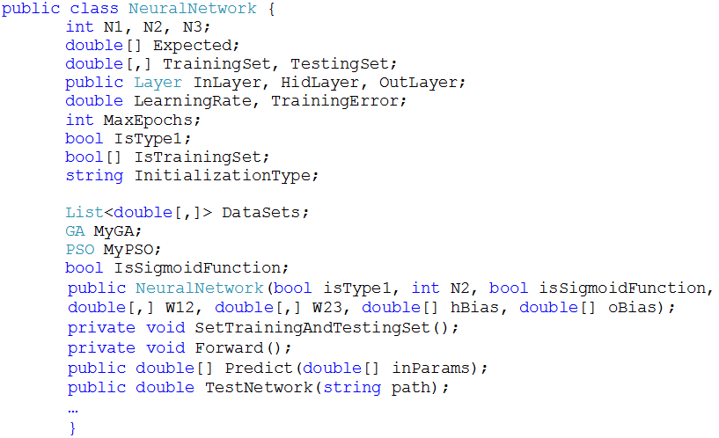
2nd approach: NN class members and methods in C#
Notes:
Categorisire: part of AI and pattern matching (Process 2020) and paralel and distributed Systems
Multistrat/Single perceptron
Feedback/Feedforward
Constrângeri (neuronii de pe același strat nu sunt conectati)
Exemplu Matlab (cod sursa)
Crearea rețelei, alegerea funcției de activare
Rezultate

Slide 34
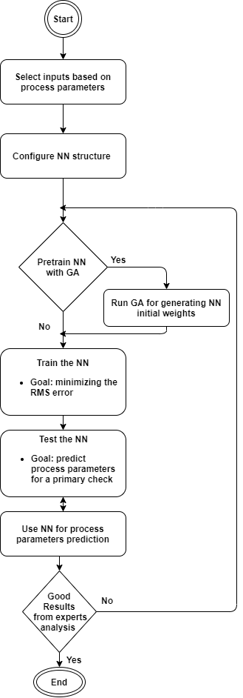
Application & Experiment organization
The application development stages consisted of:
The back-end component implements the functionality of the application the configuration of the NN and its prediction.
The front-end component contains all the design and presentation features of the application (ASP.NET, HTML 5.0, CSS and JavaScript).
Through this implementation mode, the application is available remotely, facilitating its operation without the need to be near the bioreactor.
Notes:
Categorisire: part of AI and pattern matching (Process 2020) and paralel and distributed Systems
Multistrat/Single perceptron
Feedback/Feedforward
Constrângeri (neuronii de pe același strat nu sunt conectati)
Exemplu Matlab (cod sursa)
Crearea rețelei, alegerea funcției de activare
Rezultate

Slide 35
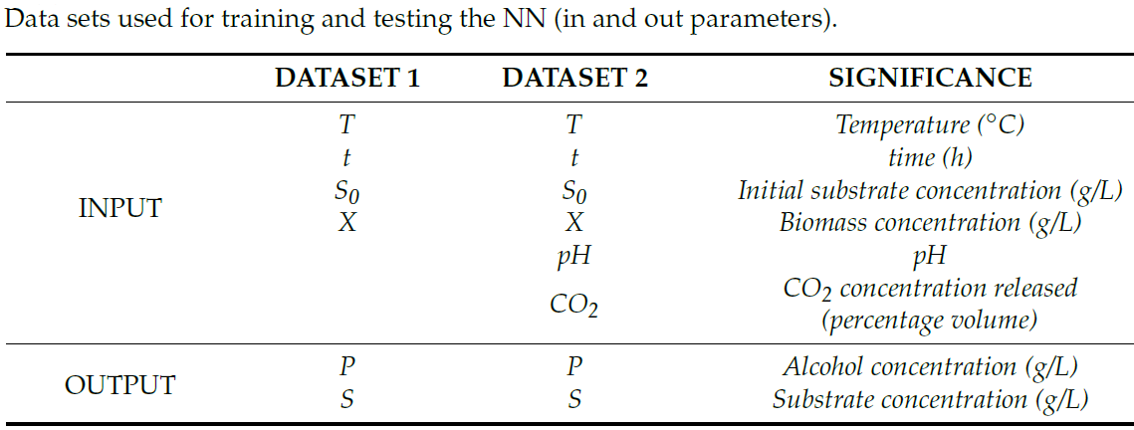
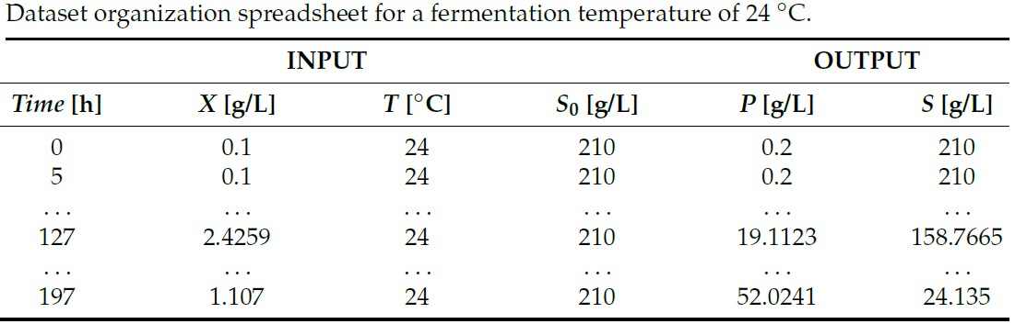
Fermentation process parameters
Notes:
Categorisire: part of AI and pattern matching (Process 2020) and paralel and distributed Systems
Multistrat/Single perceptron
Feedback/Feedforward
Constrângeri (neuronii de pe același strat nu sunt conectati)
Exemplu Matlab (cod sursa)
Crearea rețelei, alegerea funcției de activare
Rezultate

Slide 36
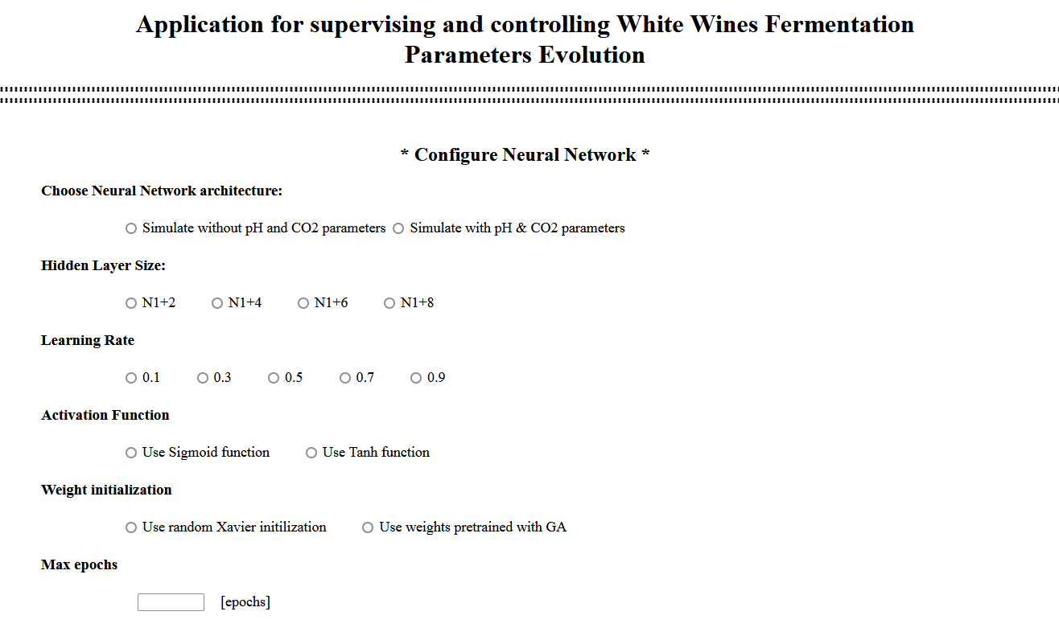
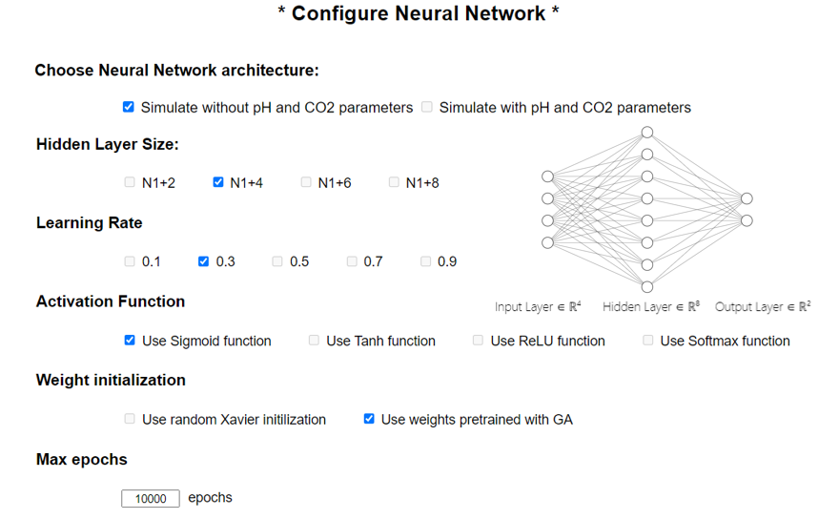
Notes:
Categorisire: part of AI and pattern matching (Process 2020) and paralel and distributed Systems
Multistrat/Single perceptron
Feedback/Feedforward
Constrângeri (neuronii de pe același strat nu sunt conectati)
Exemplu Matlab (cod sursa)
Crearea rețelei, alegerea funcției de activare
Rezultate

Slide 37
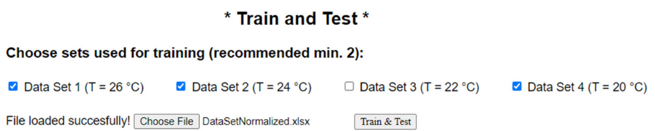
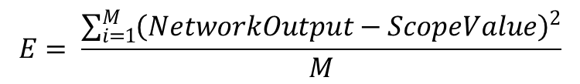
NN training and test
  Metrics
    At the end of the training phase, the errors obtained from training data are calculated with the following mean square error formula (MSE):
  where M is the pairs number of the input–output used in training.
  Training (75% of the data) & Testing phases (rest of 25% of the data)
$$E= \frac{\sum_{i=1}^{M}{{\left(NetworkOutput−ScopeValue\right)}^{2}}}{M}$$
Notes:
Categorisire: part of AI and pattern matching (Process 2020) and paralel and distributed Systems
Multistrat/Single perceptron
Feedback/Feedforward
Constrângeri (neuronii de pe același strat nu sunt conectati)
Exemplu Matlab (cod sursa)
Crearea rețelei, alegerea funcției de activare
Rezultate

Slide 38
Multi-Layer Perceptron (MLP)
Learning Mechanism: Backpropagation (BP)
Is used in feed-forward networks.
BP comprises two steps:
  The first step (forward) is where information is passed from input to output, followed by a step from output to input. The forward step propagates the input vector to the first level of the network; the outputs of this level produce a new vector that will be the input for the next level until it reaches the last level, where the outputs are the network outputs.
  The second step (backward) is similar to the forward step, except that errors are propagated backward through the network to cause the weights to adjust. Based on gradient descent for weight adjustment, the BP algorithm uses the chain rule to compute the gradient of the error for each unit with respect to its weights.
Notes:
Algoritmul scădere după gradient
▪ Se bazează pe eroarea asociată întregului set de date de antrenament
▪ Modificarea ponderilor în direcţia dată de cea mai abruptă pantă a reducerii erorii E(w)
pentru tot setul de antrenament

Slide 39
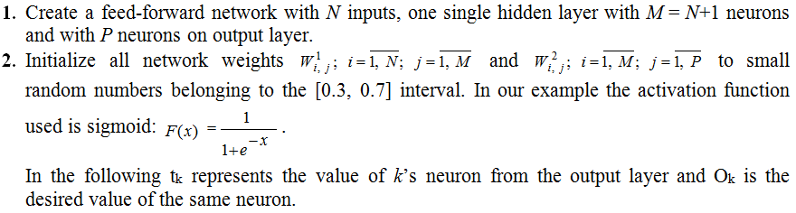
Multi-Layer Perceptron (MLP)
Learning Mechanism: Backpropagation
Feasibility issues. Constraints
Neurons from the same layer are not connected

Slide 40
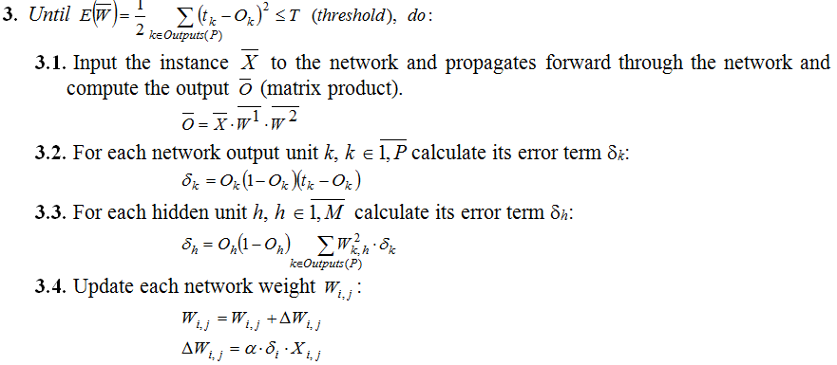
Multi-Layer Perceptron (MLP)
Learning Mechanism: Backpropagation
Notes:
The choice of alpha (learning rate) greatly influences the backpropagation learning algorithm based on minimizing the mean square error. However, its choice depends on the specifics of the problem.
Although there is no universal method for choosing in a given problem, it is recommended that it be subunit or possibly decreasing with increasing iteration number.
Usually the most convenient value is chosen after laborious simulations.

Slide 41
Multi-Layer Perceptron (MLP)
Learning Mechanism: Levenberg-Marquardt (LM)
The Levenberg-Marquardt algorithm is an iterative optimizational technique that uses aspects of the gradient descent and Gauss-Newton method and is fast in practice, as we demonstrated in our experiments.
MATLAB implementation: Simulation results obtained with the original data using the Levenberg-Marquardt and the Backpropagation algorithms respectively.
No. of Iterations | No. of Hidden Layers | No. of Neurons on Hidden Layers | Average Error
 |  |  | Levenberg-Marquardt Algorithm | Backpropagation Algorithm
1500 | 1 | 5 | 3.5498 | 5.6236
1500 | 1 | 6 | 2.2282 | 5.4599
1500 | 1 | 7 | 1.6872 | 4.5100
1500 | 1 | 8 | 1.7170 | 3.9243
1500 | 1 | 9 | 1.3018 | 4.6077
1500 | 1 | 10 | 1.9558 | 5.9983
1500 | 1 | 11 | 2.0424 | 3.8234
1500 | 1 | 12 | 0.9954 | 4.0962
net.trainFcn = 'trainlm' – in MATLAB
[trainedNet,tr] = train(net,...)
Notes:
Algoritmul scădere după gradient
Traingdx Matlab - Gradient descent with momentum and adaptive learning rate backpropagation
▪ Se bazează pe eroarea asociată întregului set de date de antrenament
▪ Modificarea ponderilor în direcţia dată de cea mai abruptă pantă a reducerii erorii E(w) pentru tot setul de antrenament

Slide 42
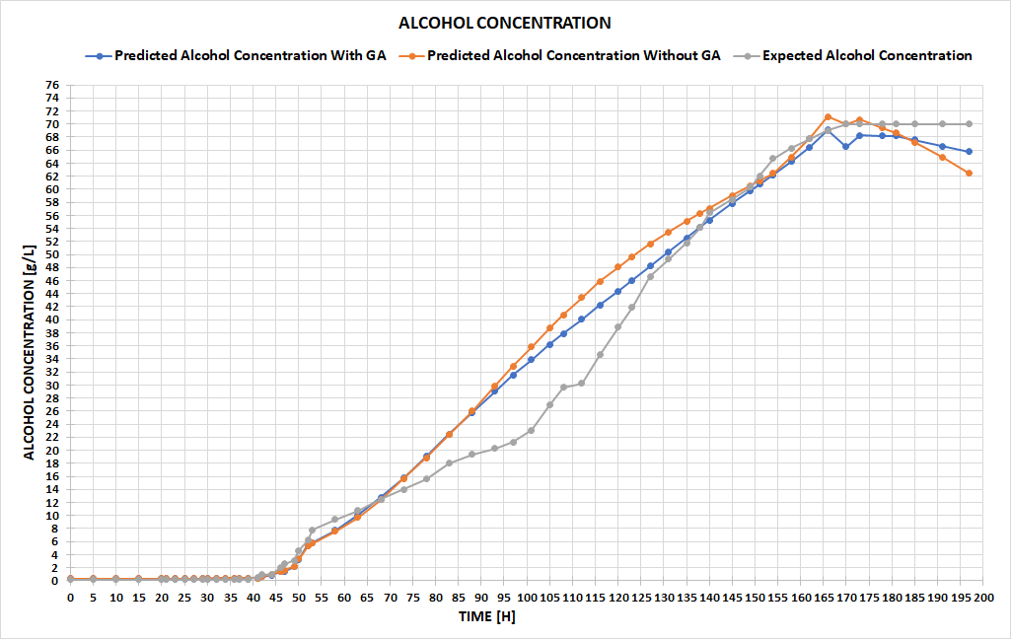
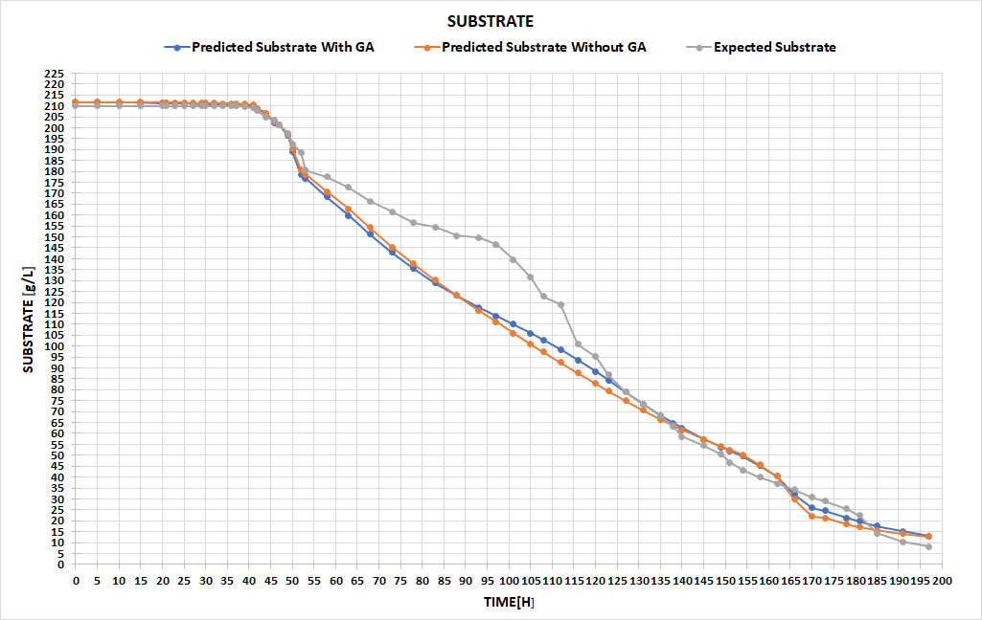
Neural Networks Results (I)
Random Initialization vs. GA Initialization of NN weights
We achieved better results with the neural network pre-trained with the genetic algorithm, with a testing error of 0.03 compared to 0.045 in the case of the pseudo-random Xavier initialization.
Notes:
Categorisire: part of AI and pattern matching (Process 2020) and paralel and distributed Systems
Multistrat/Single perceptron
Feedback/Feedforward
Constrângeri (neuronii de pe același strat nu sunt conectati)
Exemplu Matlab (cod sursa)
Crearea rețelei, alegerea funcției de activare
Rezultate

Slide 43
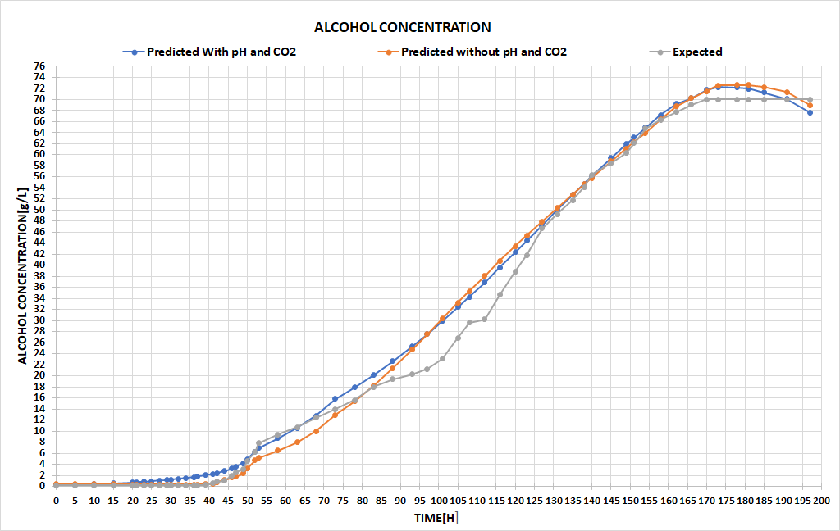
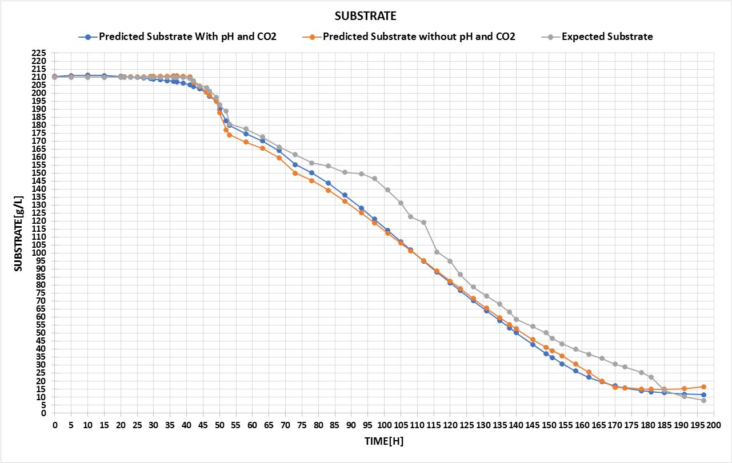
Neural Networks Results (II)
Incorporating the pH and the released CO₂ in the prediction process
There was an increase in the prediction accuracy once the additional information about the pH and the released carbon dioxide was incorporated, leading to the conclusion that a larger amount of data positively influences the performance of the NN.
Notes:
Categorisire: part of AI and pattern matching (Process 2020) and paralel and distributed Systems
Multistrat/Single perceptron
Feedback/Feedforward
Constrângeri (neuronii de pe același strat nu sunt conectati)
Exemplu Matlab (cod sursa)
Crearea rețelei, alegerea funcției de activare
Rezultate

Slide 44
Neural Networks: Challenges
The choice of alpha (learning rate) greatly influences the backpropagation learning algorithm based on minimizing the mean square error. However, its choice depends on the specifics of the problem.
Although there is no universal method for choosing in a given problem, it is recommended that it be subunit or possibly decreasing with increasing iteration number. Usually the most convenient value is chosen after laborious simulations.
Difficult to customize Machine Learning models for specific food types or recall types
Are necessary complex Machine Learning models and large volumes of data to ensure accurate predictions
Time-consuming simulations and AI models training requiring days/weeks to be performed
Notes:
Categorisire: part of AI and pattern matching (Process 2020) and paralel and distributed Systems
Multistrat/Single perceptron
Feedback/Feedforward
Constrângeri (neuronii de pe același strat nu sunt conectati)
Exemplu Matlab (cod sursa)
Crearea rețelei, alegerea funcției de activare
Rezultate

Slide 45
Genetic Algorithms (GA)
The most widely known type of Evolutionary Algorithms
Quick overview
Advantages of GA. Limitations of GA.
Structure of a Genetic Algorithm (pseudocod)
GA: Individual/Chromosome Representation
GA: Fitness & parents selection
Genetic operators: Recombination & Mutation
GA: Survivor selection
  Application & Results
https://webspace.ulbsibiu.ro/adrian.florea/html/Planificari/EvolutionaryComputing/Planif_EvolutionaryComputing_ACS_2.pdf
Notes:
Categorisire: part of AI and pattern matching (Process 2020) and paralel and distributed Systems
Multistrat/Single perceptron
Feedback/Feedforward
Constrângeri (neuronii de pe același strat nu sunt conectati)
Exemplu Matlab (cod sursa)
Crearea rețelei, alegerea funcției de activare
Rezultate

Slide 46
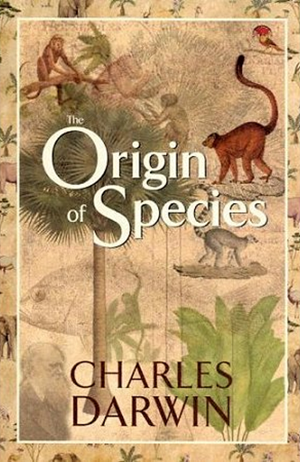
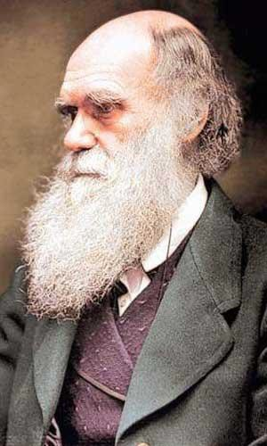

Evolutionary Algorithms Inspiration: Mother Nature
"It is not the strongest of the species that survives, nor the most intelligent that survives. It is the one that is the most adaptable to change."
1859

Slide 47

How survive ?
Competition,
survival of the fittest
Variation introduced into a population
  Parental recombination
  Mutation
Variations that provide a selective advantage stick around:
  elitist / generational
In Nature:

Slide 48

At the Molecular Level:
How survive ?
It’s all about the DNA
Heritable traits: genes
Variation introduced through parental recombination and mutation

Slide 49

Variation Through Mutation
In nature:
  Environmental factors
  Radiation
  Oxidation
  Mistakes in replication
  or repair

Slide 50
What is Evolutionary Computing / Algorithms ?
Evolutionary computing began by lifting ideas from biological evolutionary theory into computer science, and continues to look toward new biological research findings for inspiration.
Darwin’s principle “Survival of the fittest” and „Natural selection and genetic inheritance!” can be used as a starting point in introducing evolutionary algorithms / computing.
Although the history of evolutionary computing dates back to the 1950s and 1960s, only within the last two decades have evolutionary algorithms became practicable for solving real-world problems on desktop computers.

Slide 51
The Main Evolutionary Computing Metaphor
PROBLEM SOLVING
Problem
Candidate Solution
Quality
Set of potential solutions
Encoding of potential solutions
Part of encoding
EVOLUTION
Environment
Individual
Fitness
Population
Chromosome
Gene
Fitness → chances for survival and reproduction
Quality → chance for seeding new solutions
Notes:
The fundamental methaphor of Evolutionary Computing relates the powerful natural evolution to a particularly style of problem solving – that of trial-and-error or a.k.a. Generate and test. Learning doesn't happen from failure itself but rather from analyzing the failure, making a change, and then trying again.
In the macroscopic view of evolution, natural selection plays a central role. Given an environment that can host a only a limited number of individuals, and the basic instincts of individuals to reproduce, selection becomes inevitable if the population size is not to grow exponentially. Natural selection favours those individuals that are adapted or fit to the environmental condition best (survival of the fittest).

Slide 52
Advantages of GA
Parallelism
Solution space is wider
The problem has multi objective function
Easily modified for different problems
They require no knowledge or gradient information about the response surface and only uses function evaluations
They are resistant to becoming trapped in local optima
They perform very well for large-scale optimization problems
Can be employed for a wide variety of optimization problems

Slide 53
Limitations of GA
The problem of identifying fitness function
Definition of representation for the problem
Premature convergence occurs
Cannot easily incorporate problem specific information
Not good at identifying local optima
Needs to be coupled with a local search technique (memetic algorithms)
Have trouble finding the exact global optimum
Require large number of response (fitness) function evaluations
Configuration is not straightforward

Slide 54

General Scheme of EAs

Slide 55

The generic structure of EAs
Notes:
The algorithms usually start by creating an initial population of one or more individuals. These first individuals are created randomly or by another process. These individuals are then evaluated. If the individuals satisfy the stop conditions (they are good enough, the allocated time has elapsed, etc.) the results are returned.
If the stop condition has not been met the individuals are modified (all of them or only a part of them) using different operators and a new population is generated. The new population is again evaluated and the algorithm continues.
Some of the evolutionary algorithms use all the operators some of them use only a part. This is where usually the difference between algorithms appears.

Slide 56

Pseudo-code for typical EA
1 – Select parents – stochastic
5 – Survival selection – deterministic
Notes:
1 – Select parents – stochastic
5 – Survival selection – deterministic

Slide 57
Genetic Algorithms (pseudocod)
Procedure GA{
t = 0;
Initialize P(t);
Evaluate P(t);
While (Not Done)
{
Parents(t) = Select_Parents(P(t));
Offspring(t) = Procreate(Parents(t));
Evaluate(Offspring(t));
P(t+1)= Select_Survivors(P(t),Offspring(t));
t = t + 1;
}
To solve a problem using a genetic algorithm is necessary to define a fitness function (F) to evaluate the performance of each chromosome.
Notes:
To solve a problem using a genetic algorithm is necessary to define a fitness function (F) to evaluate the performance of each chromosome.

Slide 58
GA: Individual / Chromosome Representation
Representation - The most critical decision in any application, namely that of deciding how best to represent a candidate solution of the algorithm
Binary encoding
Permutation
Integer encoding
Real valued problems
Based on the representation – it depends the setting of genetic operators and the computing of fitness function!
Notes:
To solve a problem using a genetic algorithm is necessary to define a fitness function (F) to evaluate the performance of each chromosome.

Slide 59
GA: Binary Representation
Binary Representation (knapsack problem object selection, loading trucks, combinatorial problems, maximum/minimum, FPGA chip design)
The knapsack problem is a problem in combinatorial optimization: Given a set of items, each with a weight and a value, determine the number of each item to include in a collection so that the total weight is less than or equal to a given limit and the total value is as large as possible.
It derives its name from the problem faced by someone who is constrained by a fixed-size knapsack and must fill it with the most useful items.
A bitvector with an entry for each potential item, a 1 if in the sack, a 0 if not
0 | 0 | 1 | 0 | 1 | 1 | 0 | 1 | 0 | 0
Notes:
To solve a problem using a genetic algorithm is necessary to define a fitness function (F) to evaluate the performance of each chromosome.

Slide 60



GA: Permutation representation
Permutation Representation (Traveling Salesman Problem / Vehicle Routing Problem)
Problem:
  Given n cities
  Find a complete tour with minimal length
Encoding:
  Label the cities 1, 2, … , n
  One complete tour is one permutation (e.g. for n =4 [1,2,3,4], [3,4,2,1] are OK)
Search space is BIG:
for 30 cities there are 30! ≈ 10³² possible tours
The 8 queens problem
Obvious mapping
Notes:
The queen from the first column is on the first row. The queen from the second column is on the third row.

Slide 61
GA: Integer Representation
Integer Representation (image processing parameters, microarchitectural configuration)
public class PSATSimSolutionType: SolutionType {
public override Variable[] CreateVariables(Problem problem)
{
var variables = new PSATSimVariable[problem.NumberOfVariables];
variables[0] = new PSATSimVariable(1, 16, "Super-Scalar Factor");
variables[2] = new PSATSimVariable(1, 512, "Reorder entries", MutationType.Exponential);
variables[6] = new PSATSimVariable(1, 8, "Integer Execution Units");
…
}}
Extend bit-flipping mutation from binary representation to make random choice (esp. categorical variables)
Notes:
To solve a problem using a genetic algorithm is necessary to define a fitness function (F) to evaluate the performance of each chromosome.

Slide 62

GA: Real values Representation
Real valued problems (continuous parameter optimisation, using a GA for Neural Network training in order to increase prediction accuracy)
Each individual has a finite number of genes, which in this case are represented by the linear matrix of weights, where one weight of NN corresponds to one gene.
Notes:
To solve a problem using a genetic algorithm is necessary to define a fitness function (F) to evaluate the performance of each chromosome.

Slide 63

GA: Mapping real values on bit strings
Notes:
To solve a problem using a genetic algorithm is necessary to define a fitness function (F) to evaluate the performance of each chromosome.

Slide 64
GA: Parent Selection Methods
GA researchers have used a number of parent selection methods. Some of the more popular methods are:
  Proportionate Selection (FPS or roulette wheel)
  individuals are assigned a probability of being selected based on their fitness
  p_{i} = f_{i} / Σf_{j}
  where p_{i} is the probability that individual i will be selected, f_{i} is the fitness of individual i, and Σ f_{j} represents the sum of all the fitnesses of the individuals with the population.
  Rank based Selection (Linear, Exponential)
    Attempt to remove problems of FPS by basing selection probabilities on relative rather than absolute fitness
    This imposes a sorting overhead on the algorithm, but this is usually negligible compared to the fitness evaluation time
  Tournament Selection
    Two members are selected at random to compete against each other with only the winner of the competition progressing to the next level of the tournament.
Notes:
To solve a problem using a genetic algorithm is necessary to define a fitness function (F) to evaluate the performance of each chromosome.
Proportionate selection - This type of selection is similar to using a roulette wheel where the fitness of an individual is represented as proportionate slice of wheel. The wheel is then spun and the slice underneath the wheel when it stops determine which individual becomes a parent.

Slide 65
GA: Genetic Procreation Operators
Genetic Algorithms typically use two types of operators:
  Crossover (Sexual Recombination), and
  Mutation (Asexual)
Crossover is usually the primary operator with mutation serving only as a mechanism to introduce diversity in the population.
However, when designing a GA to solve a problem it is not uncommon that one will have to develop unique crossover and mutation operators that take advantage of the structure of the chromosomes comprising the search space.
Notes:
To solve a problem using a genetic algorithm is necessary to define a fitness function (F) to evaluate the performance of each chromosome.
Proportionate selection - This type of selection is similar to using a roulette wheel where the fitness of an individual is represented as proportionate slice of wheel. The wheel is then spun and the slice underneath the wheel when it stops determine which individual becomes a parent.

Slide 66
GA: Types of Crossover
However, there are a number of crossover operators that have been used on binary and real-coded GAs:
Single-point Crossover
n-point Crossover
Uniform Crossover
Half-uniform Crossover
Crossover operators used on permutation representation of GAs:
Order 1 crossover Crossover
Partially matched Crossover
Cycle Crossover
Edge Crossover
Notes:
To solve a problem using a genetic algorithm is necessary to define a fitness function (F) to evaluate the performance of each chromosome.
Proportionate selection - This type of selection is similar to using a roulette wheel where the fitness of an individual is represented as proportionate slice of wheel. The wheel is then spun and the slice underneath the wheel when it stops determine which individual becomes a parent.

Slide 67
GA: Alternative Mutation Operators
Through mutation are introduced in the population individuals which could not be generated by other mechanisms.
Mutation operators used on binary and real-coded GAs:
Strong Mutation
Weak Mutation
Single chromosome (individual) mutation
Not uniform mutation
Adaptive not-uniform mutation
Mutation operators used on permutation representation of GAs:
Insert Mutation
Swap Mutation
Inversion mutation
Scramblemutation
Notes:
To solve a problem using a genetic algorithm is necessary to define a fitness function (F) to evaluate the performance of each chromosome.
Proportionate selection - This type of selection is similar to using a roulette wheel where the fitness of an individual is represented as proportionate slice of wheel. The wheel is then spun and the slice underneath the wheel when it stops determine which individual becomes a parent.

Slide 68
GA: Crossover OR mutation?
Decade long debate: which one is better / necessary / main-background
Answer (at least, rather wide agreement):
  it depends on the problem, but
  in general, it is good to have both
  both have another role
  mutation-only-EA is possible, xover-only-EA would not work
Achieving a balance between information exploitation and by the state-space exploration to obtain new better solutions, is typical of all powerful optimization methods.
If the solutions obtained are exploited too much, then reaches a premature convergence.
On the other hand, if too much emphasis on exploration, it is possible that the information already obtained is not used properly. Search time grows and approaches that of random search methods.
Notes:
To solve a problem using a genetic algorithm is necessary to define a fitness function (F) to evaluate the performance of each chromosome.
Proportionate selection - This type of selection is similar to using a roulette wheel where the fitness of an individual is represented as proportionate slice of wheel. The wheel is then spun and the slice underneath the wheel when it stops determine which individual becomes a parent.

Slide 69
GA: Crossover OR mutation? (cont’d)
Exploration: Discovering promising areas in the search space, i.e. gaining information on the problem
Exploitation: Optimising within a promising area, i.e. using information
There is co-operation AND competition between them
Crossover is explorative, it makes a big jump to an area somewhere “in between” two (parent) areas
Mutation is exploitative, it creates random small diversions, thereby staying near (in the area of) the parent
Notes:
To solve a problem using a genetic algorithm is necessary to define a fitness function (F) to evaluate the performance of each chromosome.
Proportionate selection - This type of selection is similar to using a roulette wheel where the fitness of an individual is represented as proportionate slice of wheel. The wheel is then spun and the slice underneath the wheel when it stops determine which individual becomes a parent.

Slide 70
An Example Run (Steady-State GA)
This process of:
  Selecting two parents,
  Allowing them to create two offspring, and
  Immediately replacing the two worst individuals in the population with the offspring
Is repeated until a stopping criterion is reached
Notice that on each cycle the steady-state GA will make two function evaluations while a generational GA will make P (where P is the population size) function evaluations.
Therefore, you must be careful to count only function evaluations when comparing generational GAs with steady-state GAs.
Notes:
To solve a problem using a genetic algorithm is necessary to define a fitness function (F) to evaluate the performance of each chromosome.
Proportionate selection - This type of selection is similar to using a roulette wheel where the fitness of an individual is represented as proportionate slice of wheel. The wheel is then spun and the slice underneath the wheel when it stops determine which individual becomes a parent.

Slide 71
GA: Additional Properties
Generation Gap: The fraction of the population that is replaced each cycle. A generation gap of 1.0 means that the whole population is replaced by the offspring. A generation gap of 0.02 (given a population size of 100) means two offsprings replace two parents.
Elitism: The fraction of the population that is guaranteed to survive to the next cycle. An elitism rate of 0.98 (given a population size of 100) means 98 parents survive and an elitism rate of 0.02 means that only 2 parents survive.
Notes:
To solve a problem using a genetic algorithm is necessary to define a fitness function (F) to evaluate the performance of each chromosome.
Proportionate selection - This type of selection is similar to using a roulette wheel where the fitness of an individual is represented as proportionate slice of wheel. The wheel is then spun and the slice underneath the wheel when it stops determine which individual becomes a parent.

Slide 72

Applying GA for training weights of NN
The fitness function used to evaluate each individual is the backpropagation algorithm itself, while the fitness score is the output of this algorithm, the network error that resulted after training the network for the specific number of epochs selected by the user.
Notes:
Categorisire: part of AI and pattern matching (Process 2020) and paralel and distributed Systems
Multistrat/Single perceptron
Feedback/Feedforward
Constrângeri (neuronii de pe același strat nu sunt conectati)
Exemplu Matlab (cod sursa)
Crearea rețelei, alegerea funcției de activare
Rezultate

Slide 73



Bring diversity to population in GA
Uniform crossover, with $P_{crossover}$ probability
$$P_{mutation_new}=P_{mutation_old}∗ e^{(1−generation_{no})∗Beta}$$
Uniform mutation with $P_{mutation}$ probability
Notes:
Categorisire: part of AI and pattern matching (Process 2020) and paralel and distributed Systems
Multistrat/Single perceptron
Feedback/Feedforward
Constrângeri (neuronii de pe același strat nu sunt conectati)
Exemplu Matlab (cod sursa)
Crearea rețelei, alegerea funcției de activare
Rezultate

Slide 74


Running WineFermentation and training NN with GA

Slide 75


Prediction Tool

Slide 76
Fuzzy Systems (FS) & Fuzzy Rules (FR)
Quick overview. Terminology: Input, output, membership functions
Advantages of FS
Fuzzy Rules: Fuzzification, Inference and Defuzzification
Application: Irrigation system automate control / Wine fermentation
Notes:
Un sistem poate fi descris prin marimi fizice care iau valori reale, precise bine determinate intr-un domeniu de valori – crisp values
Valorile fuzzy – valori vagi, imprecise

Slide 77
Advantages of Fuzzy Logic Systems (FLS)
Fuzzy Logic is a method of reasoning (a precise problem-solving methodology) that resembles human reasoning applied in industrial process control systems.
The mathematical foundations of fuzzy reasoning are extremely straightforward
The flexibility of fuzzy logic allows you to change a FLS by simply adding or deleting rules
Robust setup - FLS help in dealing engineering uncertainties: are capable of accepting distorted, noisy, imprecise input data
FLS are simple to build and comprehend
Fuzzy logic systems can be programmed in a situation when feedback sensors stop working
Large applicability: cement factories, steam turbines, trains and subways, water purification, irrigation process, wine fermentation, power plants, prediction of energy production / consumption, airplanes, autonomous driving and car equipments (automatic transmision, braking system), household appliances, etc.
Notes:
Crisp set defines the value is either 0 or 1. Fuzzy set defines the value between 0 and 1 including both 0 and 1. It is also called a classical set. It specifies the degree to which something is true.
Fuzzification is the process of converting a clear input (crisp) to a fuzzy value. It converts a clear point value of the process state variable to be compatible with the representation of the fuzzy set of the system state variable in the precedent of the rule.
the gradual membership functions specific to involved linguistic variables, as shown below (fuzzification).
Voice recognition, handwriten recognition – fuzzy logic application

Slide 78
FR: Quick overview. Terminology
Fuzzy logic are based on fuzzy set theory developed by Lotfi Zadeh since 1965. Classical sets can be described by a characteristic function. In the classical theory of sets, the characteristic function associated of a set A, for a given element x is 1 or 0 depending if x belongs or not to A, respectively.
Crisp values – physical quantities that take real, precise, well-determined values in a range
Crisp rules have problems with uncertainty
Fuzzy sets are supersets of crisp sets aimed for:
  Modeling of imprecise concepts like
Age, Weight, Height, …
  Modeling of imprecise dependencies (rules):
IF age IS young AND car-power IS high THEN risk IS high
  Representation of information extracted from inherently imprecise data
Notes:
The human brain can reason with uncertainties, vagueness, and judgments. Computers can only manipulate precise valuations. Fuzzy logic is an attempt to combine the two techniques

Slide 79

Crisp rules
Consist of antecedents and consequents
Each part of an antecedent is a logical expression
  e.g. A > 0.5, light is on
Consequent will be asserted if antecedent is true
  IF (Presentation is Dull) AND (Voice is Monotone)
  THEN Lecture is boring
  Difficulties:
    Only one rule at a time allowed to fire
    A rule will either fire or not fire; Sequential firing of rules also is a problem (ordering the rules to fire!)
    Crisp rules have problems with
    uncertainty - representing concepts like
    small, large, thin, wide
    Classical Crisp Sets can be described
    by a characteristic function ⇒
Notes:
Crisp set defines the value is either 0 or 1. Fuzzy set defines the value between 0 and 1 including both 0 and 1. It is also called a classical set. It specifies the degree to which something is true.

Slide 80


FR: Terminology. Linguistic variables and values
Associating meaning (semantic) with fuzzy sets results in:
Linguistic Variables: the (labeled!) domain of the fuzzy sets
Linguistic Values: a (labeled!) collection of fuzzy sets on this domain
Linguistic values are inherently context dependent!
Examples:
Age: young, old
Size: small, medium, tall
Notes:
De adaugat din Fuzzy.pdf (LV) slides 3, 6, 7-10, 12-15, 18

Slide 81



Fuzzy Sets
Supersets of crisp sets
Items can belong to varying degrees:
degrees of membership
usually in [0,1]
Fuzzy sets are defined in two ways:
membership functions (MF, μ_{A}) - return the degree of membership in a fuzzy set (A in this case)
  Many different types in existence:
  Gaussian, Triangular, Trapezoid, Singleton
sets of ordered pairs (Crisp, Fuzzy) values
Notes:
De adaugat din Fuzzy.pdf (LV) slides 3, 6, 7-10, 12-15, 18

Slide 82

Fuzzy process flow (fuzzy inference process)
Fuzzifier converts a clear input (crisp) to a fuzzy value based on gradual membership function.
Intelligence
  applies the fuzzy rules to infer fuzzy conclusions from fuzzy facts
  assigns fuzzy sets to outputs, determined by degree of support for rules
  aggregates the outputs of fuzzy rules based on classical fuzzy operators
  Defuzzifier converts the membership function of fuzzy output values to crisp output values using Centre of Gravity or Mean of Maxima methods
Notes:
Crisp set defines the value is either 0 or 1. Fuzzy set defines the value between 0 and 1 including both 0 and 1. It is also called a classical set. It specifies the degree to which something is true.
Aggregation is the process of unification of the outputs of all rules.
We take the membership functions of all rule consequents previously clipped or scaled and combine them into a single fuzzy set.

Slide 83

Fuzzy Rules (FR): Construction & Examples
FR - also have antecedents and consequents
Both deal with partial truths
  Antecedents match fuzzy sets
  E.g. Restaurant tipping example, antecedent variables are (quality of service, quality of food)
  Consequents assign fuzzy sets
    consequent variable is Tip
    Fuzzy rules can have weightings
      usually in [0, 1]
      based on importance of each rule
  Service (range 0-10) can be:
    Poor
    Good
    Excellent
Notes:
Antecedents – premise
Consequents - consecinte

Slide 84

Fuzzy Rules: Operations
Classical Fuzzy Operators: Min/Max Norm
Notes:
Negatia (functia de apartenenta negata) este desenata punctat
Cu albastru e desenata conjunctia
Cu rosu ramane disjunctia

Slide 85

Fuzzy Rules: Operations
Classical Fuzzy Operators: Product / Bounded-Sum
Notes:
Mamdani 1975 - to control a steam engine and boiler combination by synthesizing a set of fuzzy rules obtained from people working on the system.
Sugeno - proposed by Takagi, Sugeno, and Kang to develop a systematic approach for generating fuzzy rules from a given input-output dataset. A typical fuzzy rule in a first-order Sugeno fuzzy model has the form:
IF x is A and y is B THEN z = f(x, y)

Slide 86
Fuzzy Rules: 2 main categories of fuzzy intelligence
Mandami inference systems (1975)
  It is logical
  It has wide dissemination
  It works well with human input
  Rule: IF <Antecedent> THEN <Consequent>
  Antecedent: Conjunction of fuzzy memberships
  Consequent: Fuzzy Set
  Sugeno inference systems (Takagi, Sugeno & Kang, 1985)
  It has good computational efficiency
  It is compatible with linear techniques
  It functions well with adaptive and optimization techniques
  It has guaranteed the consistency of the output volume
  It lends itself well to mathematical analysis
  Rule: IF x is A and y is B THEN z = f(x, y) => Crisp Function
Notes:
Mamdani 1975 - to control a steam engine and boiler combination by synthesizing a set of fuzzy rules obtained from people working on the system.
Sugeno - proposed by Takagi, Sugeno, and Kang to develop a systematic approach for generating fuzzy rules from a given input-output dataset. A typical fuzzy rule in a first-order Sugeno fuzzy model has the form:
IF x is A and y is B THEN z = f(x, y)

Slide 87


Fuzzy Rules: Inference Example (1)
Fuzzification of crisp inputs ⇒ Logical inference (via Min/Max - Norm) ⇒ Defuzzification
Let’s consider two rules expressed in fuzzy logic:
R1: IF age IS young AND car-power IS high THEN risk IS high
R2: IF age IS normal AND car-power IS medium THEN risk IS medium
Notes:
Mamdani 1975 - to control a steam engine and boiler combination by synthesizing a set of fuzzy rules obtained from people working on the system.
Sugeno - proposed by Takagi, Sugeno, and Kang to develop a systematic approach for generating fuzzy rules from a given input-output dataset. A typical fuzzy rule in a first-order Sugeno fuzzy model has the form:
IF x is A and y is B THEN z = f(x, y)

Slide 88

Fuzzy Rules: Inference Example (2)
Step 1: Fuzzification of crisp inputs
Step 2: Inference (Min/Max-Norm)
According the R1 rule results the membership function related to output risk=high, according AND rule’s, namely
According the R2 rule results the membership function related to output risk=medium, according to the rule
Consequently, we are superpositioning the with Then, calculate the center of gravity for the membership function resulted by superposition.
Notes:
Mamdani 1975 - to control a steam engine and boiler combination by synthesizing a set of fuzzy rules obtained from people working on the system.
Sugeno - proposed by Takagi, Sugeno, and Kang to develop a systematic approach for generating fuzzy rules from a given input-output dataset. A typical fuzzy rule in a first-order Sugeno fuzzy model has the form:
IF x is A and y is B THEN z = f(x, y)

Slide 89

Fuzzy Rules: Inference Example (3)
Step 3: Defuzzification
Center of Gravity - COG of objective membership function (objective risk, in this case) where is the membership function resulted after the processes of fuzzy logical inferences.

Slide 90
Fuzzy Inference System: Summary
Determining a set of fuzzy rules
Fuzzifying the inputs using the input membership functions
Combining the fuzzified inputs according to the fuzzy rules to establish a rule strength
Finding the consequence of the rule by combining the rule strength and the output membership function (Mamdani FLS)
Combining the consequences to get an output distribution
Defuzzifying the output distribution

Slide 91

Automation rules for first level automation type
1_Rule:
IF (Biomass = small) AND ((alcohol=const.) OR (alcohol=small)) AND (substrate concentration=const.) AND (last_phase=latent_phase)
THEN (new_phase=latent_phase)
DESCRIPTION: identify the latent phase in biomass developing
Notes:
- the bioreactor sensors used are the biomass concentration
- the predicted values used are the substrate and the alcohol concentration

Slide 92

Automation rules – C# implementation
https://de.mathworks.com/products/fuzzy-logic.html
http://jfuzzylogic.sourceforge.net/html/example_fcl.html
Notes:
- the bioreactor sensors used are the biomass concentration
- the predicted values used are the substrate and the alcohol concentration

Slide 93
Automation Rules
Fermentation phase | Latent | Exponential growth | Decay
Number of examples | 17 | 36 | 7
Time | Predicted Alcohol | Expected Alcohol | Alcohol Phase | Predicted Substrate | Expected Alcohol | Alcohol Phase
0 | 0.5924 | 0.2 | latent | 210.9708 | 210 | latent
5 | 0.6736 | 0.2 | latent | 210.8072 | 210 | latent
…
49 | 3.4505 | 3.1095 | exp. growth | 196.1738 | 197.5316 | exp. growth
50 | 4.2833 | 4.6204 | exp. growth | 182.2209 | 188.6707 | exp. growth
52 | 5.7213 | 6.2040 | exp. growth | 178.8094 | 180.5961 | exp. growth
…
191 | 79.2037 | 70.016 | decay | 15.7378 | 10.3751 | decay
212 | 79.1773 | 70.016 | decay | 13.1312 | 8.1352 | decay

Slide 94




MATLAB Neuro-fuzzy designer

Slide 95

Implementation of irrigation system fuzzy logic (1)
Used Simpful python library for implementation
from simpful import *
Implemented a class with one method to calculate the irrigation time based on the environment variables.
1. Define fuzzy variables (name, membership functions, universe of discourse) and rules as constants.
IRRIGATION_TIME_SET = {
"irrigation_time": [
{
"none": [0, 0, 2]
}, {
"short": [0, 2, 4]
} ...
],
"uod": [0, 10]
}
FLC1_RULES = [
"IF (soil_moisture IS dry) AND (air_temperature IS cold) THEN (irrigation_time IS long)",
"IF (soil_moisture IS dry) AND (air_temperature IS moderate) THEN (irrigation_time IS very_long)",
"IF (soil_moisture IS dry) AND (air_temperature IS hot) THEN (irrigation_time IS very_long)",
"IF (soil_moisture IS moderate) AND (air_temperature IS cold) THEN (irrigation_time IS short)",
"IF (soil_moisture IS moderate) AND (air_temperature IS moderate) THEN (irrigation_time IS medium)",
"IF (soil_moisture IS moderate) AND (air_temperature IS hot) THEN (irrigation_time IS medium)",
"IF (soil_moisture IS wet) THEN (irrigation_time IS none)"
]
2. Initialize the fuzzy systems
self.fs1 = FuzzySystem()
self.fs2 = FuzzySystem()
self.fs3 = FuzzySystem()

Slide 96
Implementation of irrigation system fuzzy logic (2)
3.1. Create fuzzy sets with terms and membership functions of each variable
set = FuzzySet(function = Triangular_MF(a, b, c), term = name)
set = FuzzySet(function = Trapezoidal_MF(a, b, c, d), term = name)
…
fuzzy_sets.append(set)
! Where a, b, c, d are membership function points of a term from a configuration set. (E.g. a=0, b=0, c=2, name=“none”; for Irrigation Time Set)
3.2. Add a variable into the fuzzy system
fs.add_linguistic_variable(set_name, LinguisticVariable(fuzzy_sets, universe_of_discourse = uod))
! Where set_name is the name of the variable, fuzzy_sets is defined in step 2.2 and uod is values interval.
3.3. Repeat with the other variables
4. Add the rules
self.fs1.add_rules(FLC1_RULES)
5. Calculate the output variable (irrigation time)
self.fs1.set_variable("soil_moisture", soil_moisture)
self.fs1.set_variable("air_temperature", air_temperature)
result = self.fs1.Mamdani_inference(["irrigation_time"])
irrigation_time = result["irrigation_time"]
! Where soil_moisture and air_temperature are numerical values which need to be fuzzified before calculating the irrigation time.
Full source code: https://github.com/pdany1116/is-iot-sink

Slide 97

AUTOMATION RULES

Slide 98
References
Florea, A., Sipos, A., & Stoisor, M. C. (2022). Applying AI Tools for Modeling, Predicting and Managing the White Wine Fermentation Process. Fermentation 2022, 8, 137.
Sipos, A., Florea, A., Arsin, M., & Fiore, U. (2020). Using Neural Networks to Obtain Indirect Information about the State Variables in an Alcoholic Fermentation Process. Processes 2021, 9, 74.
Gellert, A., Florea, A., Fiore, U., Zanetti, P., & Vintan, L. (2019). Performance and energy optimisation in CPUs through fuzzy knowledge representation. Information Sciences, 476, 375-391.
Berntzen, L., Florea, A., Molder, C., & Bouhmala, N. (2019). A strategy for drone traffic planning dynamic flight-paths for drones in smart cities. In SMART 2019, The Eighth International Conference on Smart Cities, Systems, Devices and Technologies.
Spolaor S., Fuchs C., Cazzaniga P., Kaymak U., Besozzi D., Nobile M.S.: Simpful: a user-friendly Python library for fuzzy logic, International Journal of Computational Intelligence Systems, 13(1):1687–1698, 2020 DOI:10.2991/ijcis.d.201012.002

